Slide 1


ML/DL for Everyone with
Lecture 10: Basic CNN

Slide 2

CNN
http://parse.ele.tue.nl/cluster/2/CNNArchitecture.jpg

Slide 3
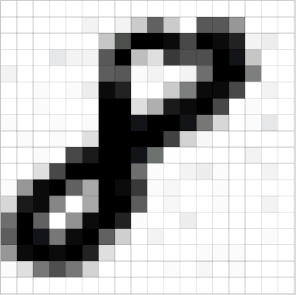
An Image is a 2D matrix

Slide 4
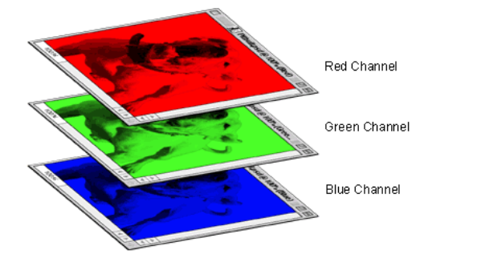
A colored image is 3 x 2d matrix

Slide 5
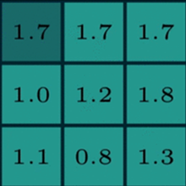
Two maxtrics interact

Slide 6
Two maxtrics interact

Slide 7
Two maxtrics interact

Slide 8
Kernel(Filter)

Slide 9
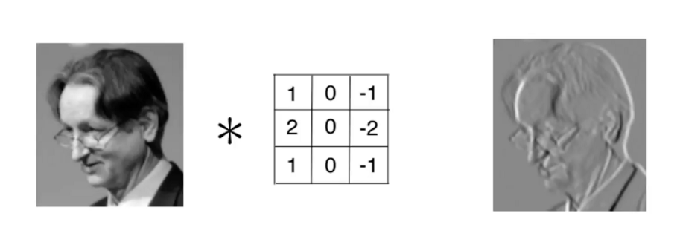
Kernel is used as Feature Detector

Slide 10
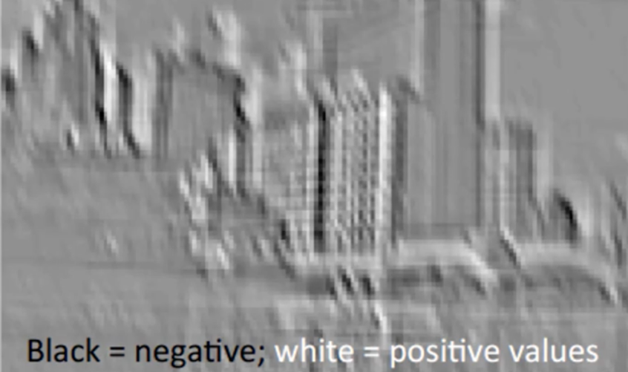
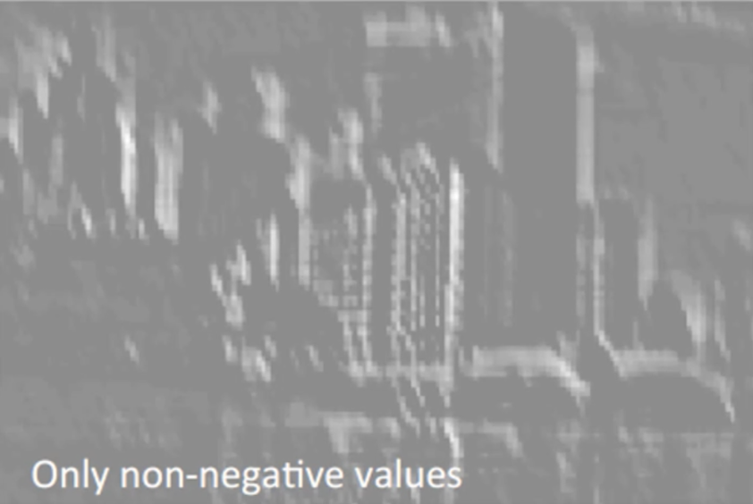
Relu, delete negative(black)

Slide 11
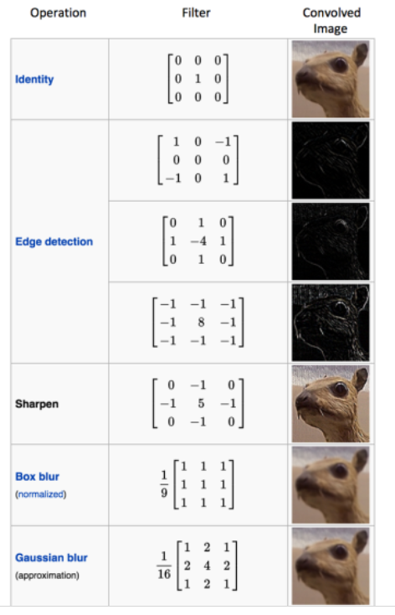
Different filters can detect different features from an image

Slide 12
CNN
Convolution
Non Linear(Relu for example)
Pooling or sub sampling( Max Pooling for example)
Classification (Full connected layer)

Slide 13
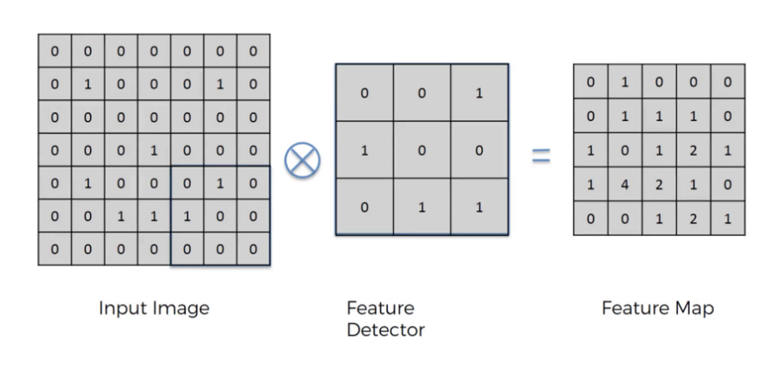
Convolution

Slide 14
Convolution
Convolution is a mathematical operation on two functions
To produce a third function that expresses how the shape of one is modified by the other.
The term convolution refers to both the result function and to the process of computing it. Convolution is similar to cross-correlation
Convolution preserves the spatial relationship between pixels by learning image features using small squares of input data.

Slide 15
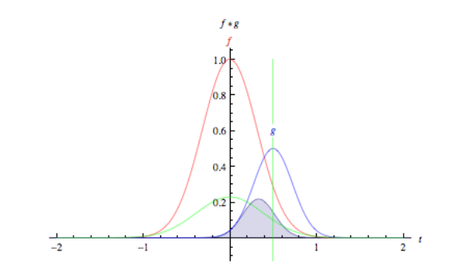
Convolution

Slide 16

Convolution

Slide 17

Two images convolve

Slide 18
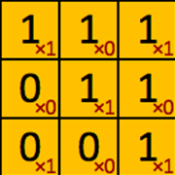
filter‘ or ‘kernel’ or ‘feature detector

Slide 19
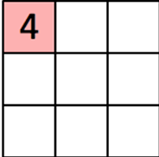
Convolved Feature’ or ‘Activation Map’ or the ‘Feature Map‘

Slide 20

Convolution operation captures the local dependencies in the original image

Slide 21
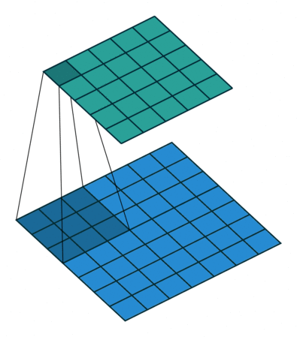
Convolution in Action
https://github.com/vdumoulin/conv_arithmetic

Slide 22
Size of featured map
Depth
Stride
Zero-padding
https://github.com/vdumoulin/conv_arithmetic

Slide 23
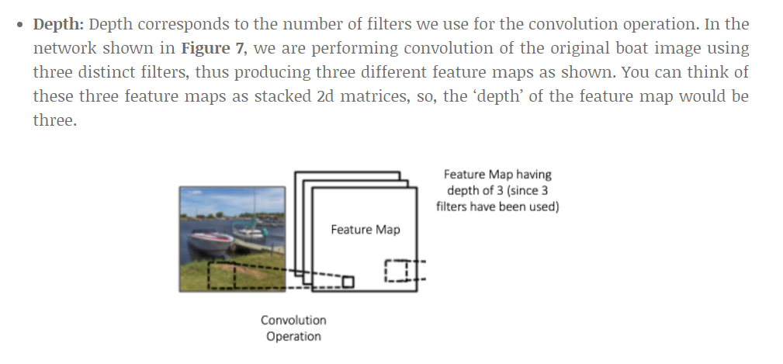
Depth
https://github.com/vdumoulin/conv_arithmetic

Slide 24
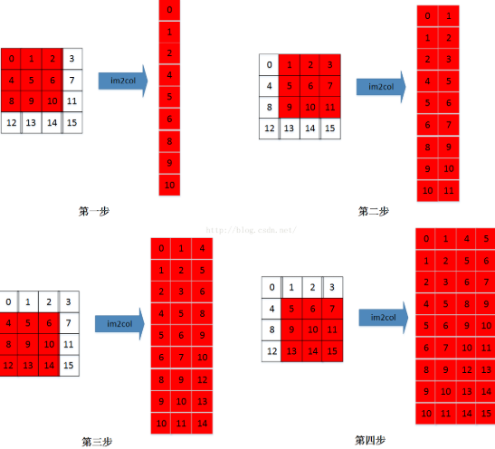
Stride

Slide 25
Zero Padding
A nice feature of zero padding is that it allows us to control the size of the feature maps. Adding zero-padding is also called wide convolution, and not using zero-padding would be a narrow convolution. This has been explained clearly in

Slide 26
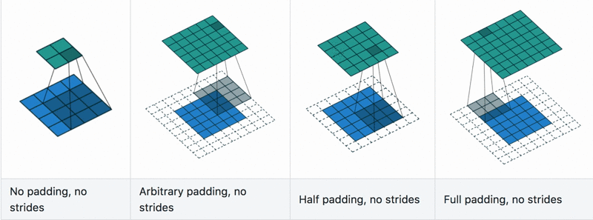
Convolution with padding in Action
https://github.com/vdumoulin/conv_arithmetic

Slide 27
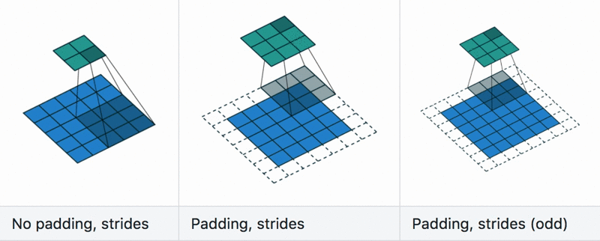
Convolution with stride in Action
https://github.com/vdumoulin/conv_arithmetic

Slide 28
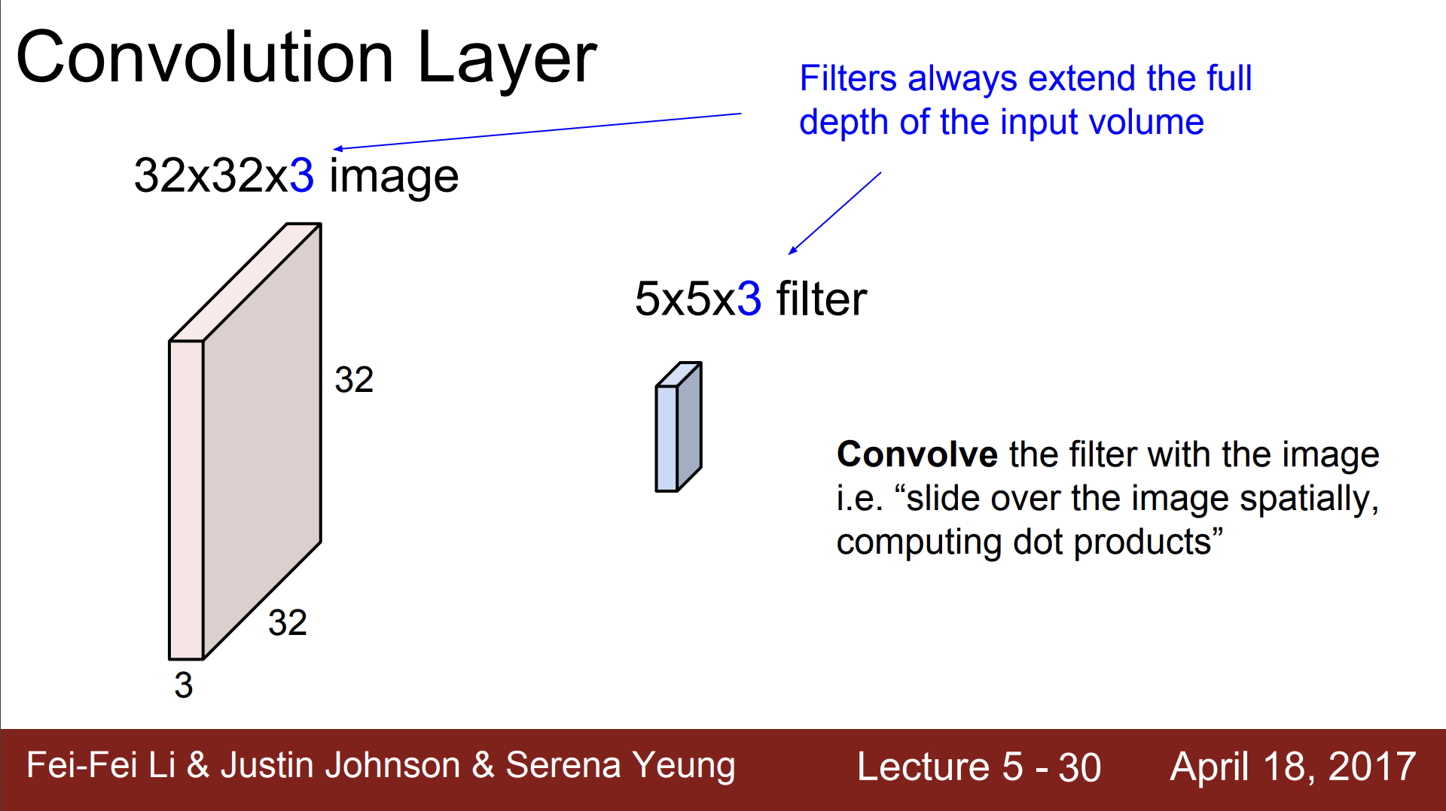

Slide 29
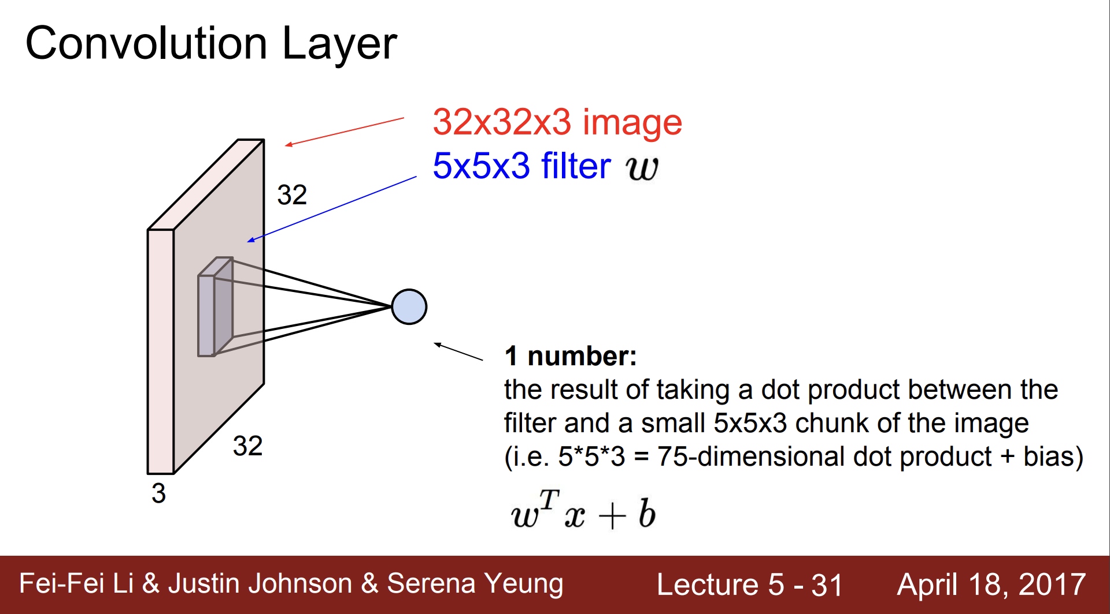

Slide 30
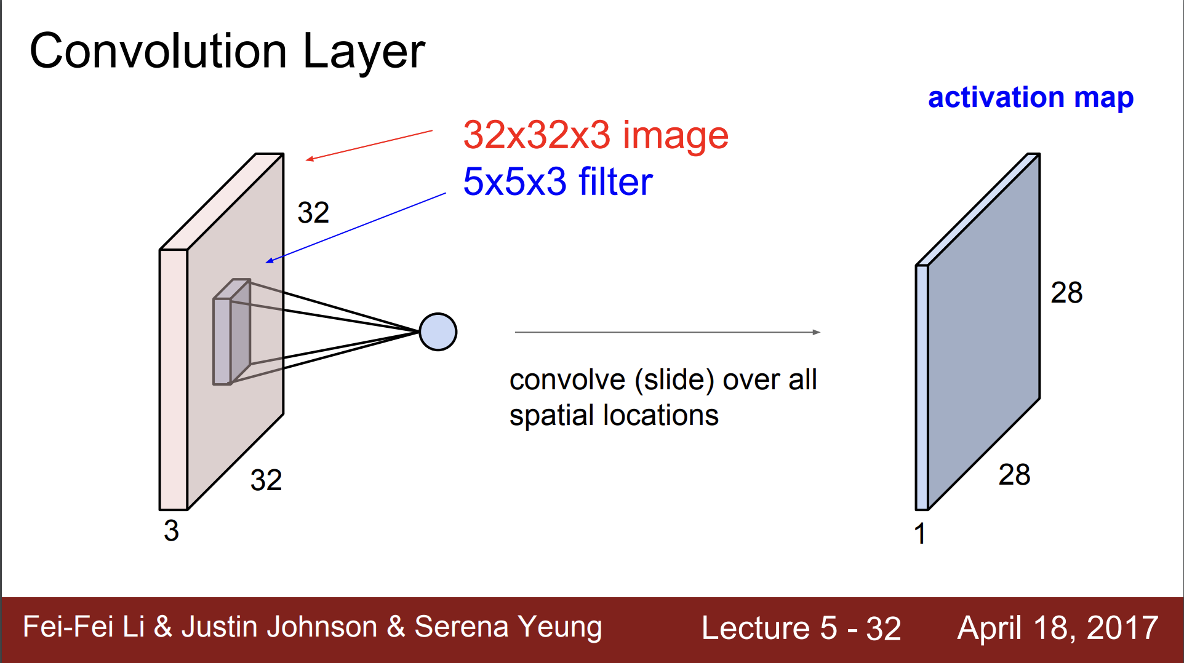

Slide 31
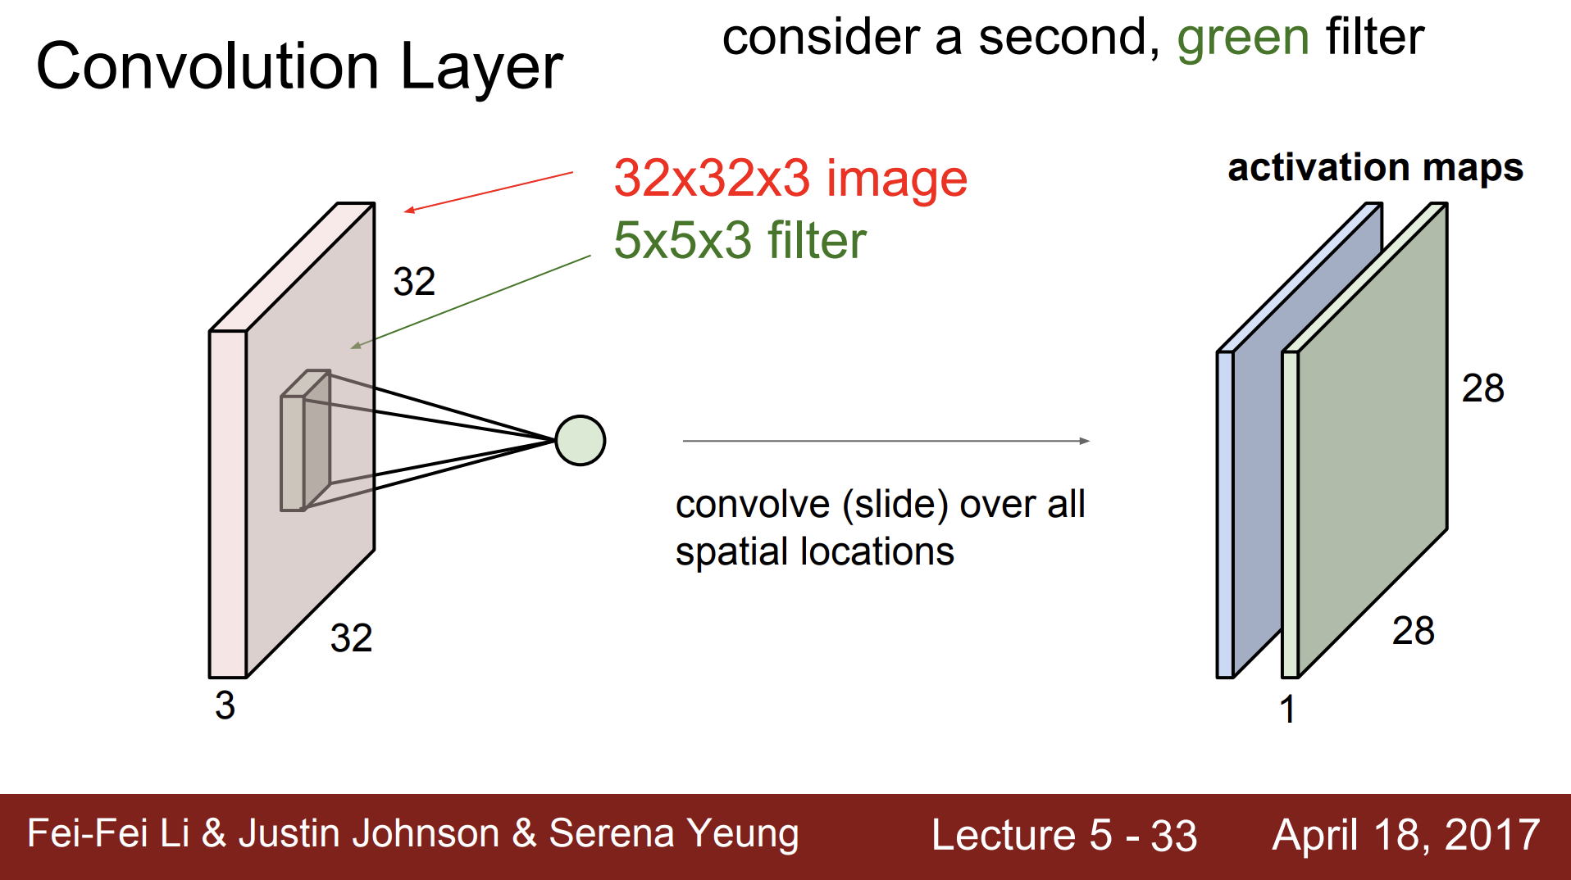

Slide 32
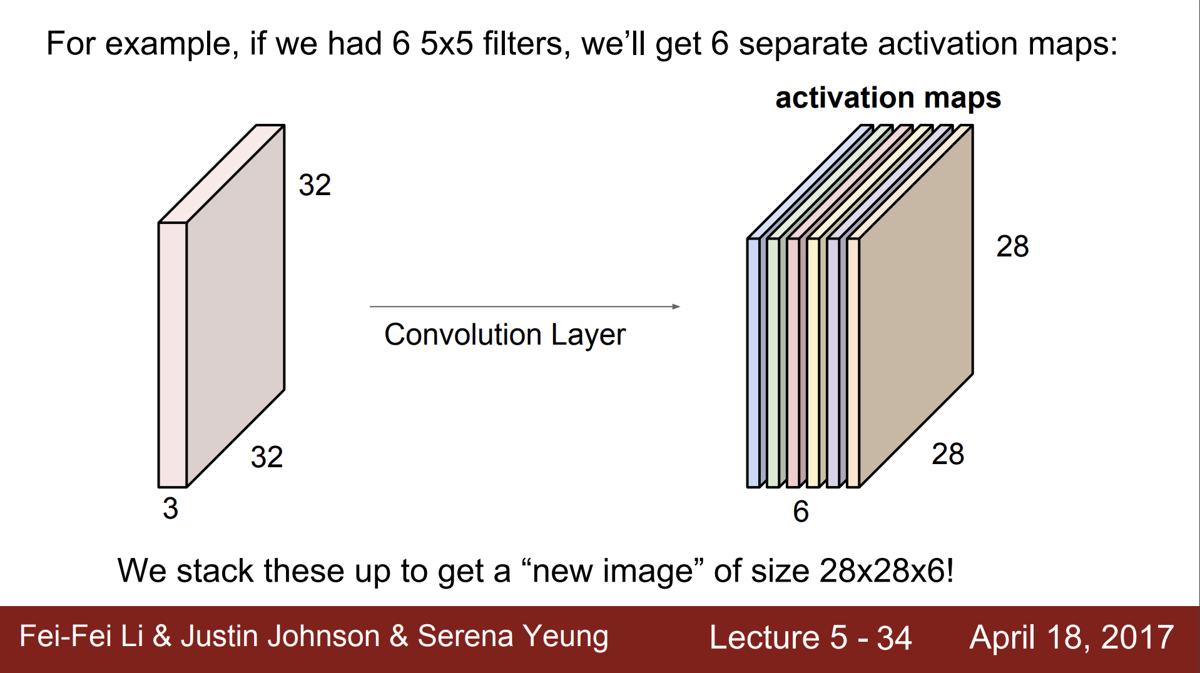

Slide 33
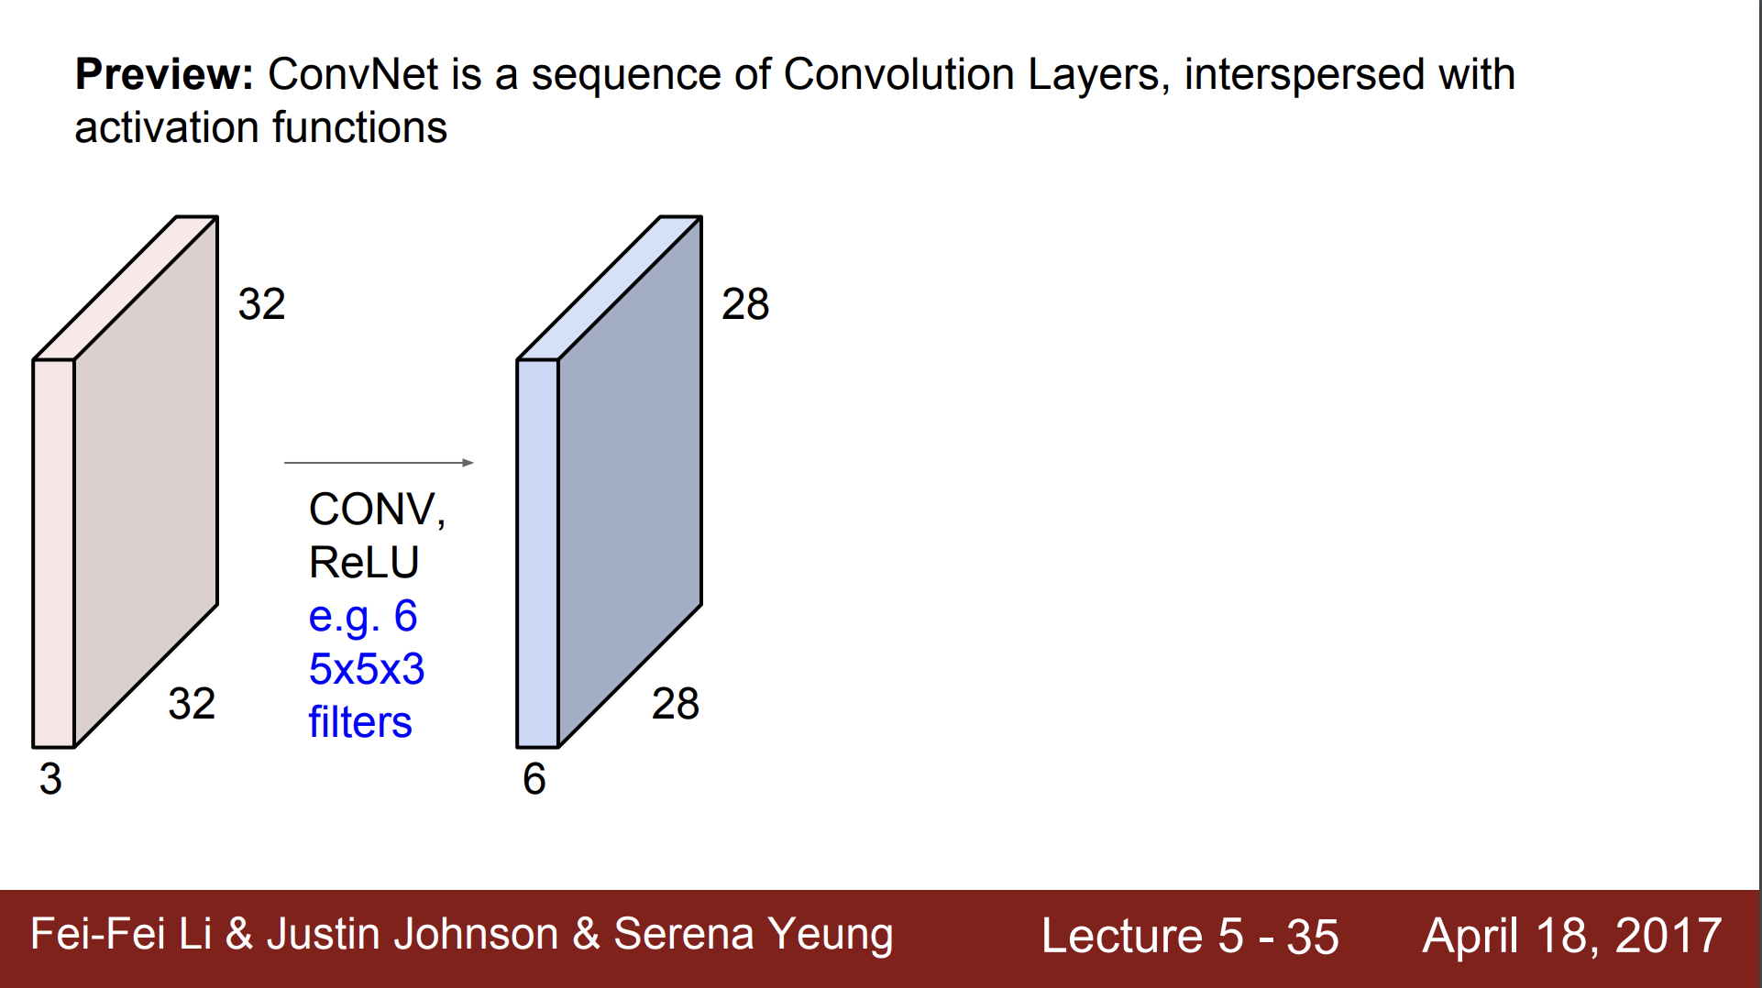

Slide 34
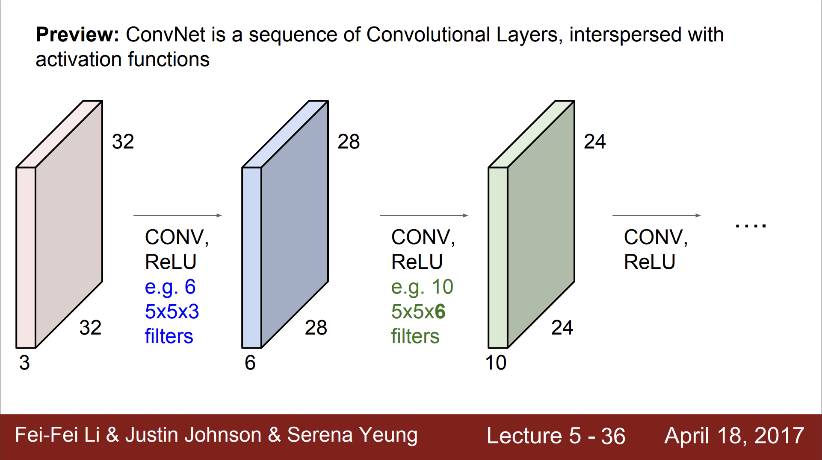

Slide 35
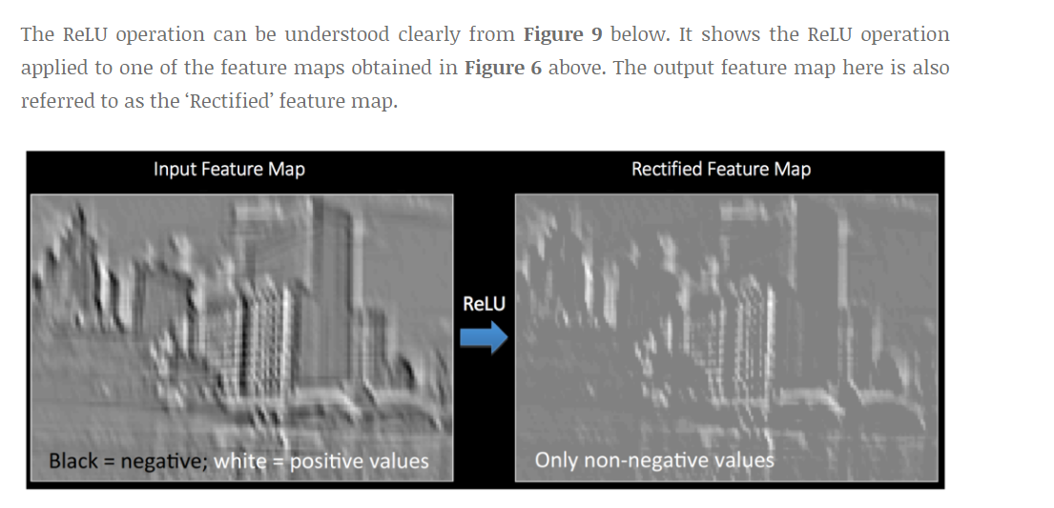
Relu

Slide 36
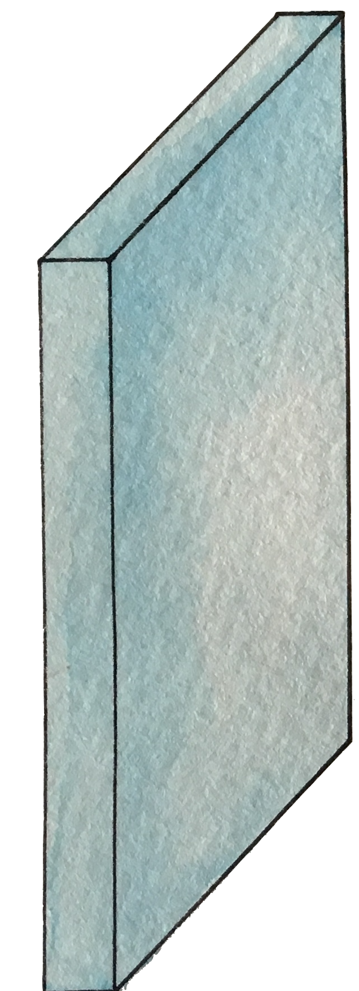
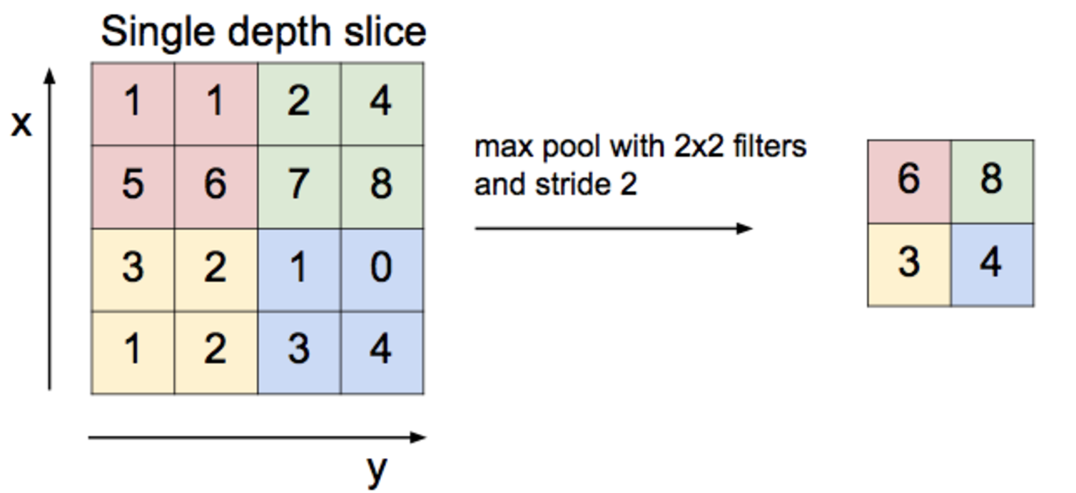
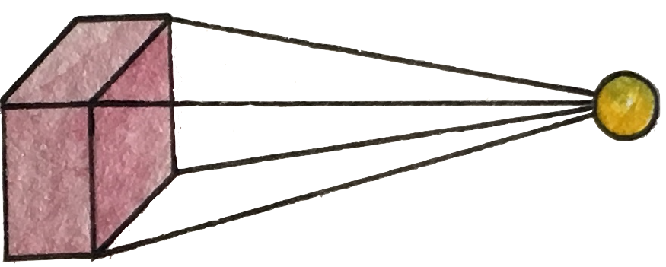
Max pooling

Slide 37
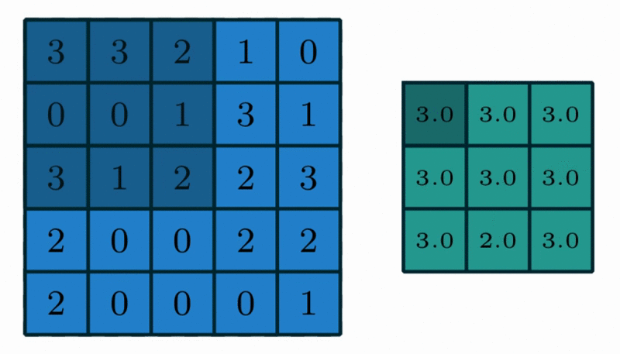
Max Pooling in Action
https://github.com/vdumoulin/conv_arithmetic

Slide 38
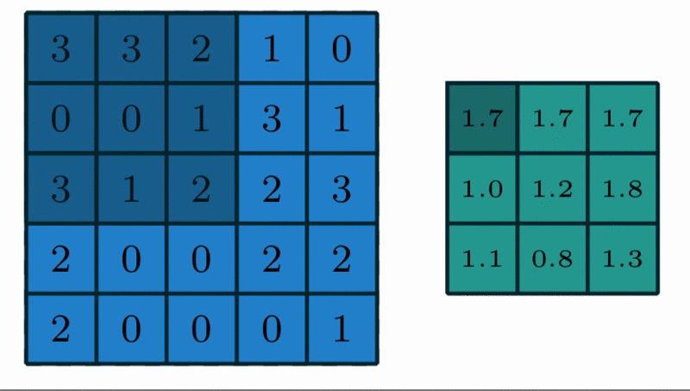
Avg Pooling in Action
https://github.com/vdumoulin/conv_arithmetic

Slide 39
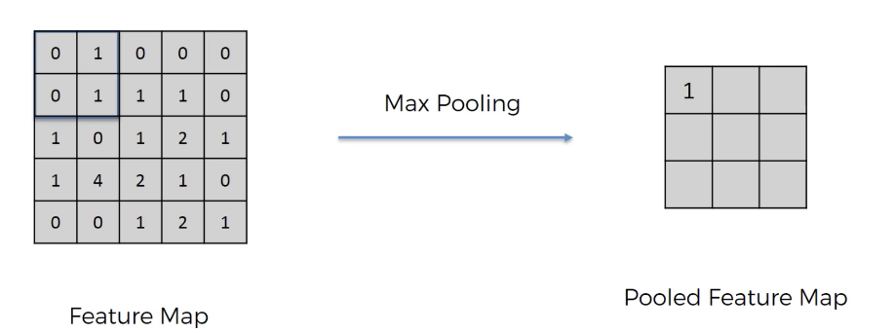
Max Pooling in Action

Slide 40
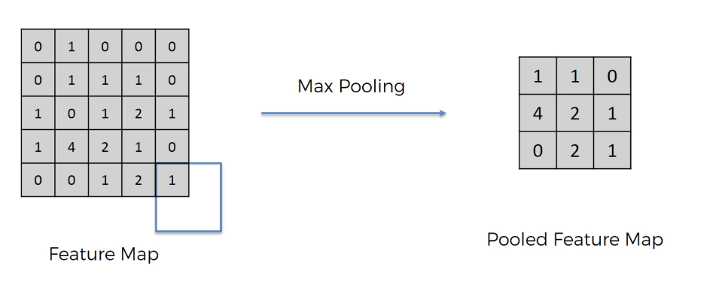
Max Pooling in Action (with padding)

Slide 41
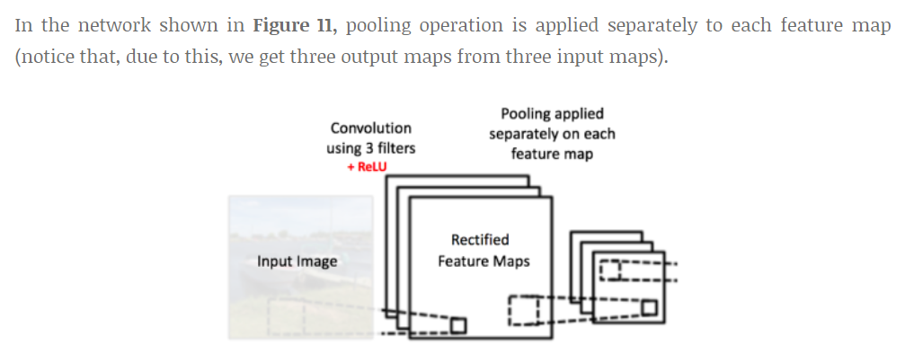
Max Pooling with depth of 3

Slide 42
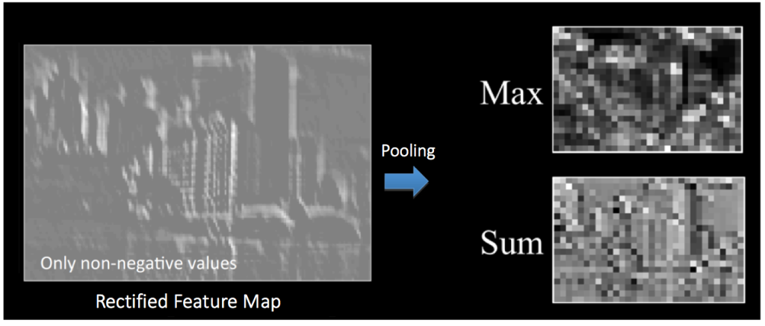
Pooling

Slide 43
Reaons of pooling
Makes the input smaller and more manageable
Reduces the number of parameters and computations in the network,
Makes the network invariant to small transformations, distortions and translations in the input image
Small distortion in input will not change the output of Pooling – since we take the maximum / average value in a local neighborhood).
Helps us arrive at an almost scale invariant representation of our image
We can detect objects in an image no matter where they are located.

Slide 44
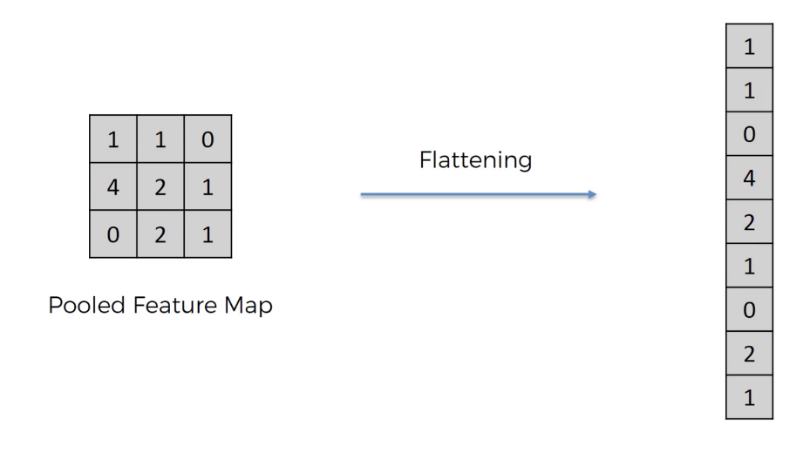
Fully Connected
https://github.com/vdumoulin/conv_arithmetic

Slide 45
Fully Connected
The Fully Connected layer is a traditional MLP that uses a softmax activation function in the output layer
The purpose of the Fully Connected layer is to use these features for classifying the input image into various classes based on the training dataset
The sum of FC layers’ probability is 1 ensured by Softmax to form a probability distribution.
https://github.com/vdumoulin/conv_arithmetic

Slide 46
CNN
http://parse.ele.tue.nl/cluster/2/CNNArchitecture.jpg

Slide 47
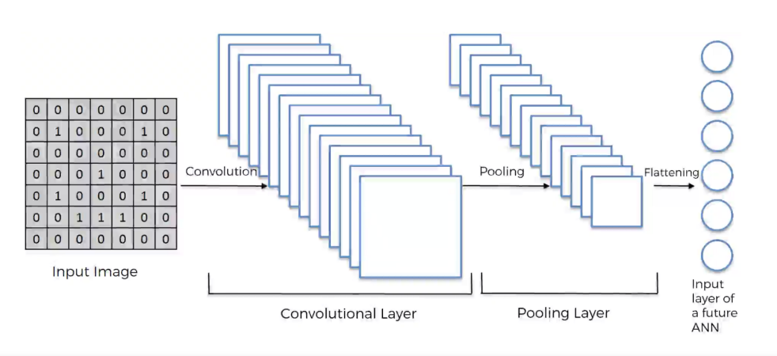
CNN

Slide 48


Slide 49
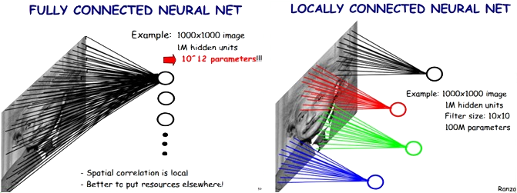
Locally Connected Features
https://ireneli.eu/2016/02/03/deep-learning-05-talk-about-convolutional-neural-network%EF%BC%88cnn%EF%BC%89/

Slide 50
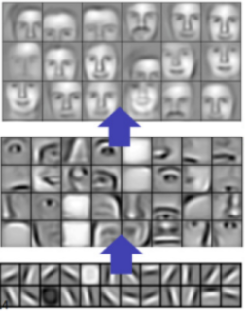
Visualize the CNN

Slide 51
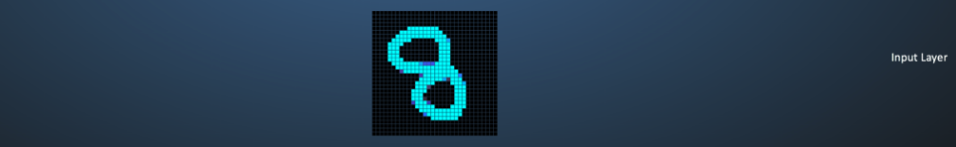
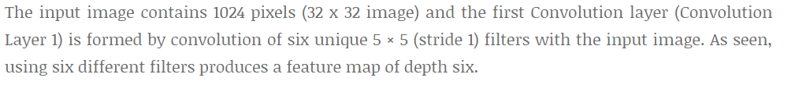
A hand-written digit ‘8’

Slide 52
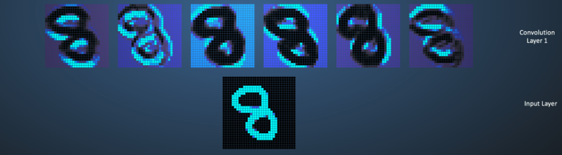
A hand-written digit ‘8’

Slide 53
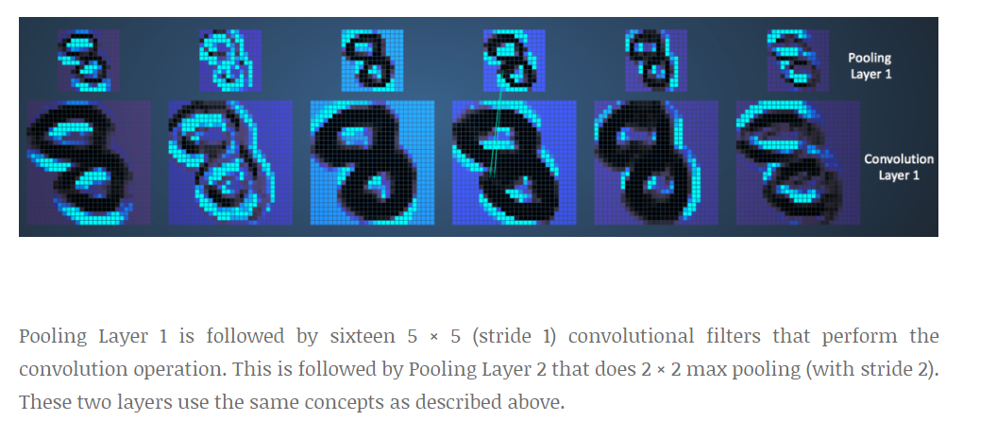
A hand-written digit ‘8’

Slide 54
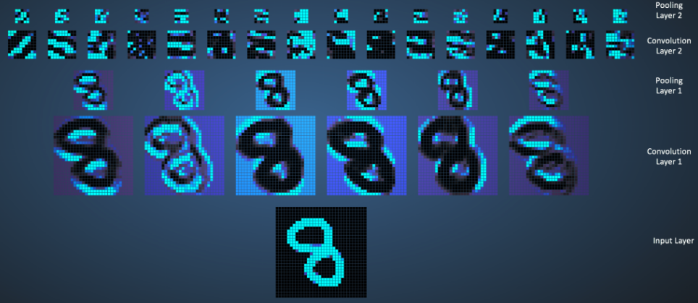
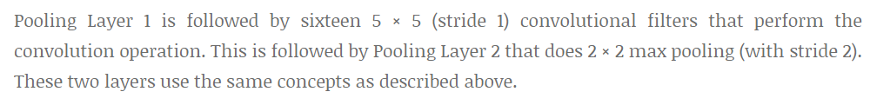
A hand-written digit ‘8’

Slide 55
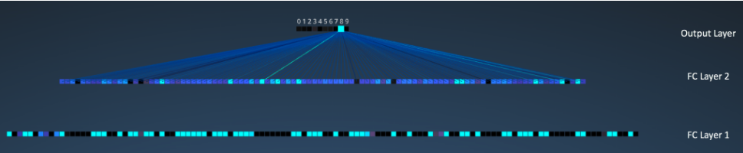
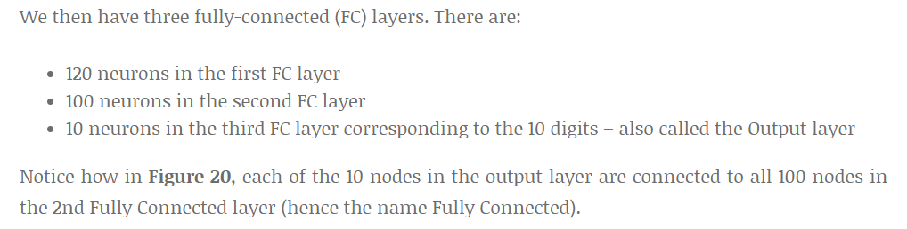
A hand-written digit ‘8’

Slide 56
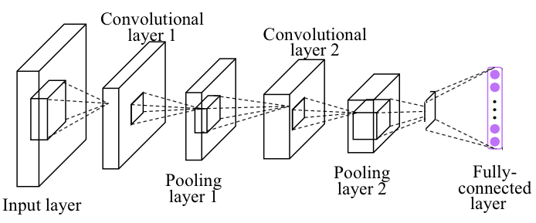
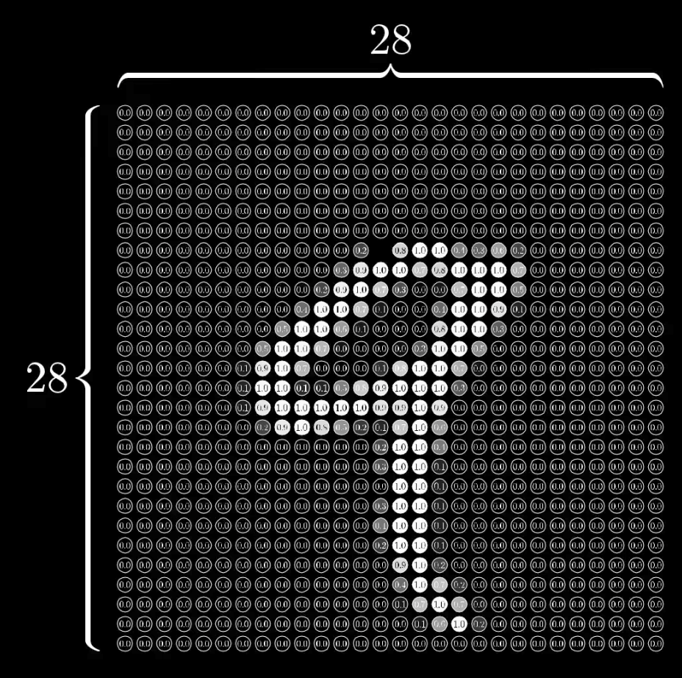
Simple CNN

Slide 57
Simple CNN
self.fc = nn.Linear(320, 10)
Linear
nn.MaxPool2d
(kernel_size)
torch.nn.Conv2d (in_channels,
out_channels,
kernel_siz)
self.mp = nn.MaxPool2d(2)
self.conv1 = nn.Conv2d(1, 10, kernel_size=5)

Slide 58

Simple CNN
class Net(nn.Module):
def __init__(self):
super(Net, self).__init__()
self.conv1 = nn.Conv2d(1, 10, kernel_size=5)
self.conv2 = nn.Conv2d(10, 20, kernel_size=5)
self.mp = nn.MaxPool2d(2)
self.fc = nn.Linear(100???, 10) # ??? -> 10
def forward(self, x):
in_size = x.size(0)
x = F.relu(self.mp(self.conv1(x)))
x = F.relu(self.mp(self.conv2(x)))
x = x.view(in_size, -1) # flatten the tensor
x = self.fc(x)
return F.log_softmax(x)
Notes:
\hat{y}=x*w+b
loss = \frac{1}{N}\sum_{n=1}^{N} y^{(n)} \log \hat{y}^{(n)} + (1 - y^{(n)}) \log (1-\hat{y}^{(n})

Slide 59
Simple CNN
class Net(nn.Module):
def __init__(self):
super(Net, self).__init__()
self.conv1 = nn.Conv2d(1, 10, kernel_size=5)
self.conv2 = nn.Conv2d(10, 20, kernel_size=5)
self.mp = nn.MaxPool2d(2)
self.fc = nn.Linear(100???, 10) # ??? -> 10
def forward(self, x):
in_size = x.size(0)
x = F.relu(self.mp(self.conv1(x)))
x = F.relu(self.mp(self.conv2(x)))
x = x.view(in_size, -1) # flatten the tensor
x = self.fc(x)
return F.log_softmax(x)
RuntimeError: size mismatch, m1: [64 x 320], m2: [100 x 10]
Notes:
\hat{y}=x*w+b
loss = \frac{1}{N}\sum_{n=1}^{N} y^{(n)} \log \hat{y}^{(n)} + (1 - y^{(n)}) \log (1-\hat{y}^{(n})

Slide 60
Simple CNN
class Net(nn.Module):
def __init__(self):
super(Net, self).__init__()
self.conv1 = nn.Conv2d(1, 10, kernel_size=5)
self.conv2 = nn.Conv2d(10, 20, kernel_size=5)
self.mp = nn.MaxPool2d(2)
self.fc = nn.Linear(320, 10) # 320 -> 10
def forward(self, x):
in_size = x.size(0)
x = F.relu(self.mp(self.conv1(x)))
x = F.relu(self.mp(self.conv2(x)))
x = x.view(in_size, -1) # flatten the tensor
x = self.fc(x)
return F.log_softmax(x)
RuntimeError: size mismatch, m1: [64 x 320], m2: [100 x 10]
Notes:
\hat{y}=x*w+b
loss = \frac{1}{N}\sum_{n=1}^{N} y^{(n)} \log \hat{y}^{(n)} + (1 - y^{(n)}) \log (1-\hat{y}^{(n})

Slide 61
Simple CNN
class Net(nn.Module):
def __init__(self):
super(Net, self).__init__()
self.conv1 = nn.Conv2d(1, 10, kernel_size=5)
self.conv2 = nn.Conv2d(10, 20, kernel_size=5)
self.mp = nn.MaxPool2d(2)
self.fc = nn.Linear(320, 10) # 320 -> 10
def forward(self, x):
in_size = x.size(0)
x = F.relu(self.mp(self.conv1(x)))
x = F.relu(self.mp(self.conv2(x)))
x = x.view(in_size, -1) # flatten the tensor
x = self.fc(x)
return F.log_softmax(x)
Train Epoch: 9 [46080/60000 (77%)] Loss: 0.108415
Train Epoch: 9 [46720/60000 (78%)] Loss: 0.140700
Train Epoch: 9 [47360/60000 (79%)] Loss: 0.090830
Train Epoch: 9 [48000/60000 (80%)] Loss: 0.031640
Train Epoch: 9 [48640/60000 (81%)] Loss: 0.014934
Train Epoch: 9 [49280/60000 (82%)] Loss: 0.090210
Train Epoch: 9 [49920/60000 (83%)] Loss: 0.074975
Train Epoch: 9 [50560/60000 (84%)] Loss: 0.058671
Train Epoch: 9 [51200/60000 (85%)] Loss: 0.023464
Train Epoch: 9 [51840/60000 (86%)] Loss: 0.018025
Train Epoch: 9 [52480/60000 (87%)] Loss: 0.098865
Train Epoch: 9 [53120/60000 (88%)] Loss: 0.013985
Train Epoch: 9 [53760/60000 (90%)] Loss: 0.070476
Train Epoch: 9 [54400/60000 (91%)] Loss: 0.065411
Train Epoch: 9 [55040/60000 (92%)] Loss: 0.028783
Train Epoch: 9 [55680/60000 (93%)] Loss: 0.008333
Train Epoch: 9 [56320/60000 (94%)] Loss: 0.020412
Train Epoch: 9 [56960/60000 (95%)] Loss: 0.036749
Train Epoch: 9 [57600/60000 (96%)] Loss: 0.163087
Train Epoch: 9 [58240/60000 (97%)] Loss: 0.117539
Train Epoch: 9 [58880/60000 (98%)] Loss: 0.032256
Train Epoch: 9 [59520/60000 (99%)] Loss: 0.026360
Test set: Average loss: 0.0483, Accuracy: 9846/10000 (98%)
Notes:
\hat{y}=x*w+b
loss = \frac{1}{N}\sum_{n=1}^{N} y^{(n)} \log \hat{y}^{(n)} + (1 - y^{(n)}) \log (1-\hat{y}^{(n})

Slide 62
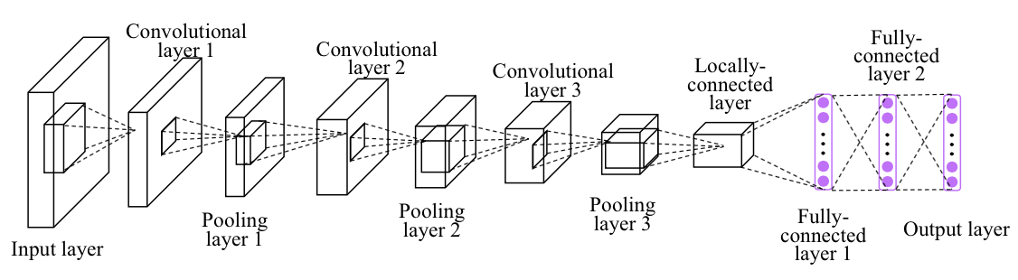
Exercise 10-1: Implement CNN more layers

